Slide 1
Xcode Overview
Vladimir Tyutin

Slide 2
Introduction

Slide 3
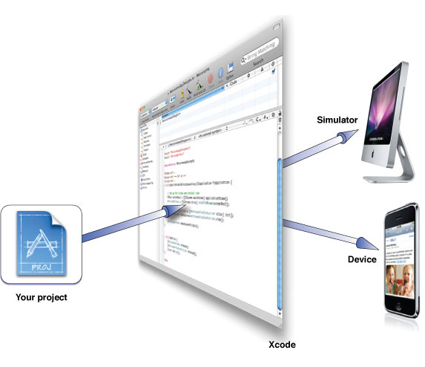
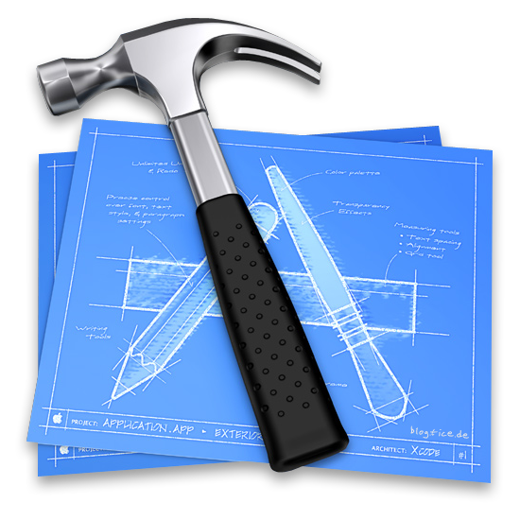
XCode
Develop iOS and Mac apps with Xcode, Apple’s integrated development environment (IDE).
Xcode provides tools to manage your entire development workflow—from creating your app, to testing, optimizing, and submitting it to the App Store.
Use the App Store app on your Mac to download Xcode.
Notes:
123

Slide 4
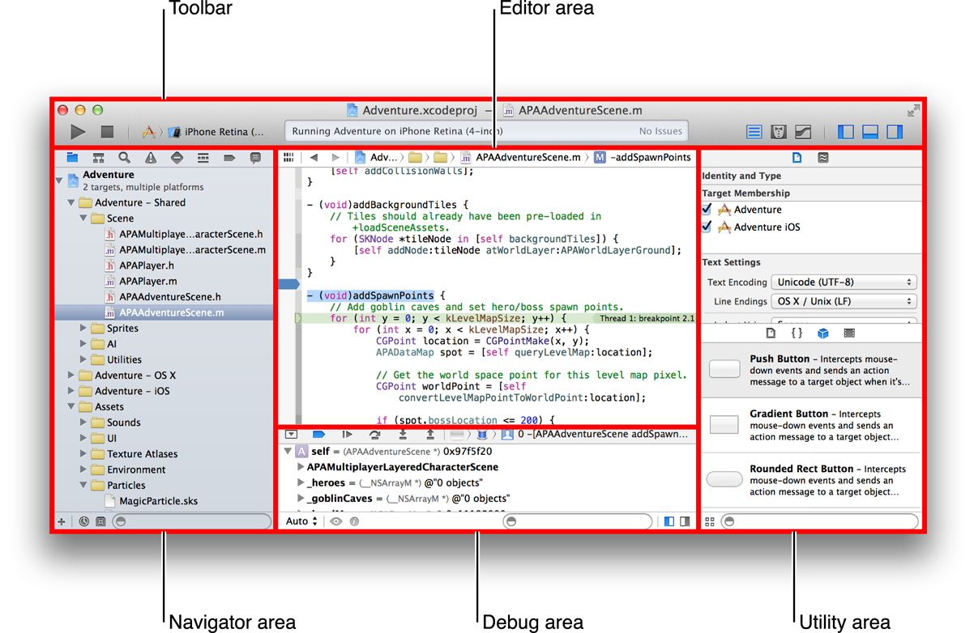
Single-Window Interface
The Xcode interface integrates code editing, user interface design, asset management, testing, and debugging within a single workspace window. The window reconfigures its content as you work. For example, select a file in one area, and an appropriate editor opens in another area. Select a symbol or user interface object, and its documentation appears in a nearby pane.
Notes:
123

Slide 5
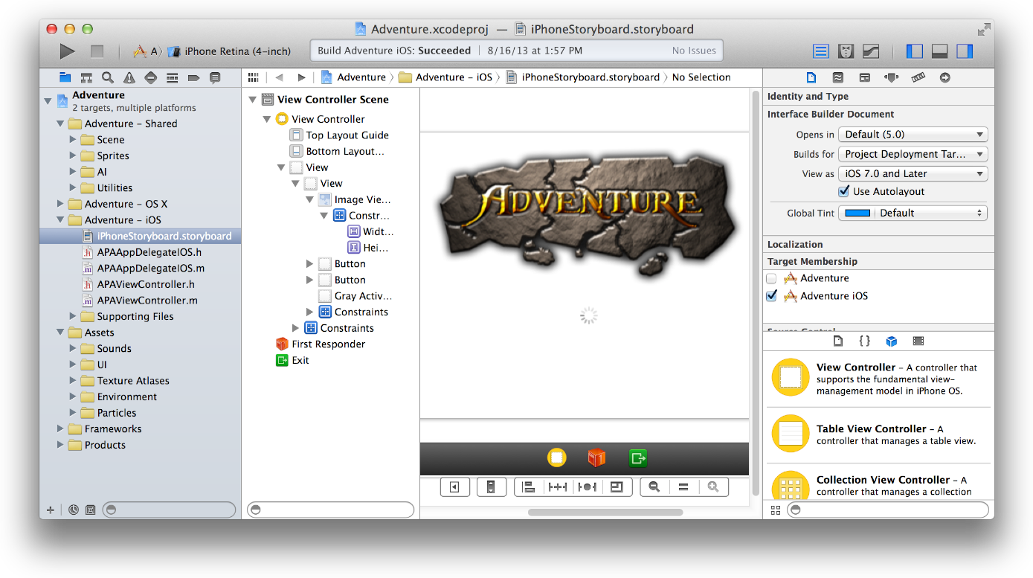
Graphical UI Design
Interface Builder is a visual design editor that’s integrated into Xcode. Use Interface Builder to create the user interfaces of your apps by assembling windows, views, controls, menus, and other elements from a library of configurable objects. Graphically connect these object to your implementation code. With the Auto Layout feature, define rules for your objects so that they automatically adjust to screen size, device orientation and window size.
Notes:
123

Slide 6
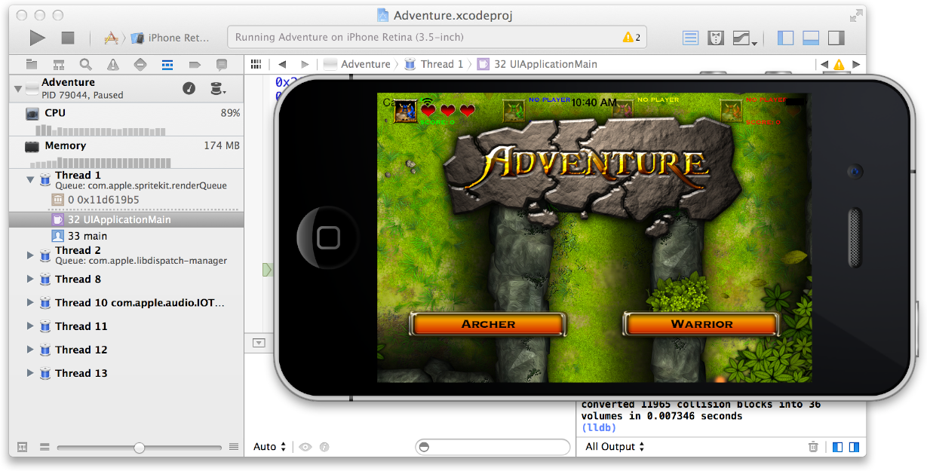
Integrated Debugging
Build your app, and Xcode launches it and immediately starts a debugging session. If you are running an iOS app, Xcode launches it either in iOS Simulator or on an iOS device connected to your Mac. If you are running a Mac app, Xcode launches it directly on your Mac.
Notes:
123

Slide 7
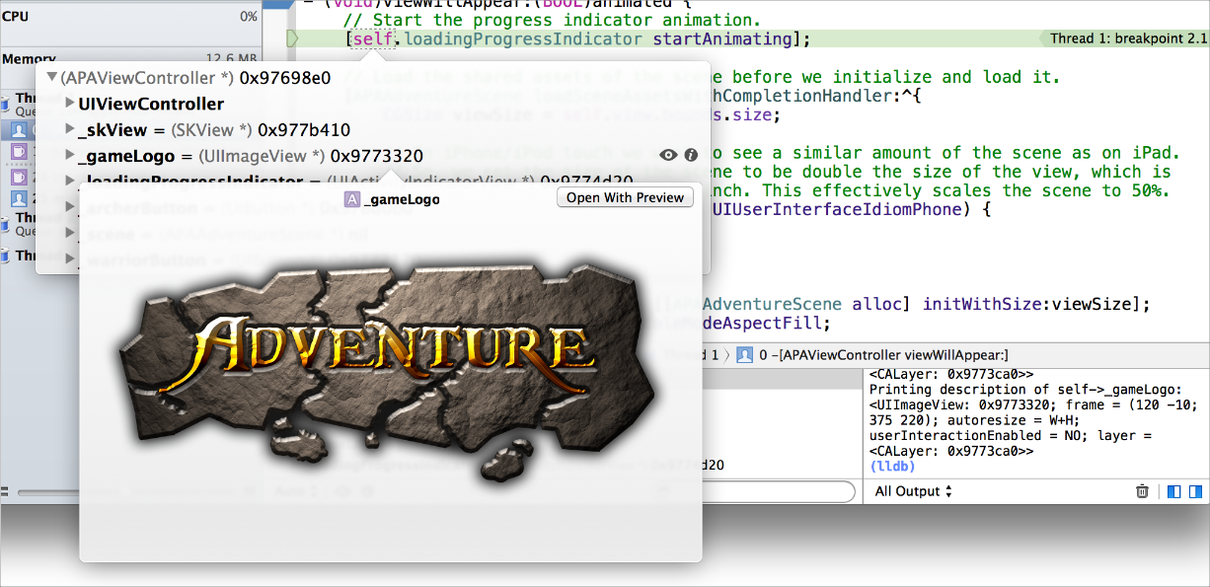
Integrated Debugging
You can debug your app directly within the source editor with graphical tools like data tips and the variables Quick Look. The debug area and the debug navigator let you carefully control the execution of your app while you examine the code.
Notes:
123

Slide 8
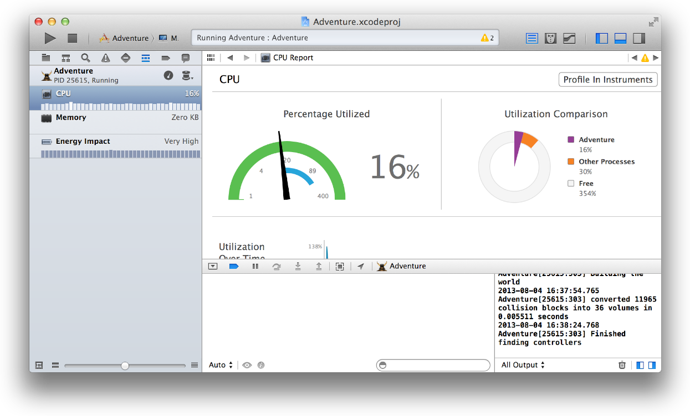
Integrated Debugging
Debug gauges display your app’s resource consumption to help you identify problems before your users do.
Notes:
123

Slide 9
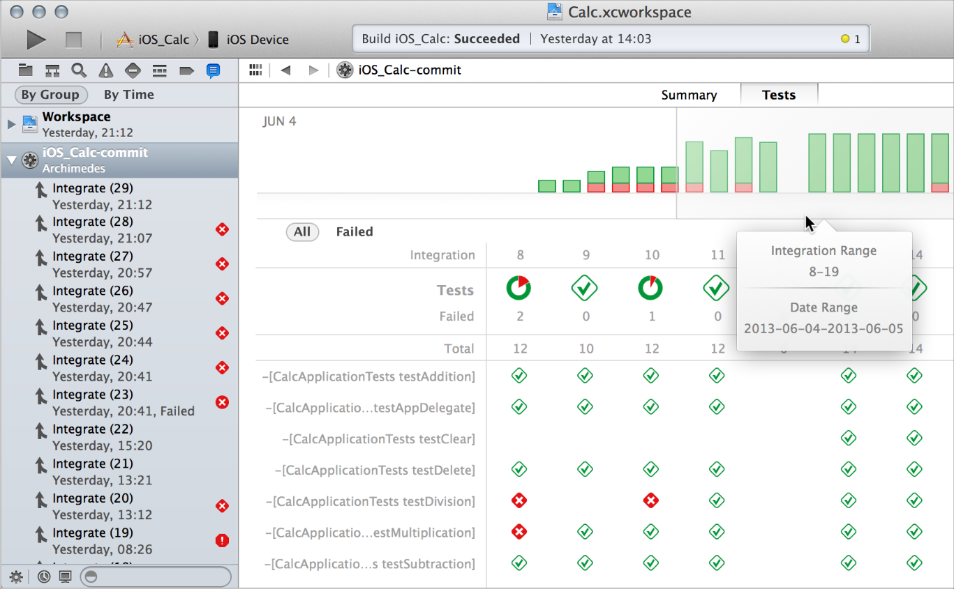
Unit Testing and Continuous Integrations
You can use the Xcode service, available in OS X Server, to automate the execution of unit tests. From Xcode on your development Mac, you create bots that run on a separate server to execute your unit tests either periodically or on every source code commit.
In addition to running unit tests, bots automatically perform static analysis on your code, build your app, and archive it for distribution to testers or the App Store.
Notes:
123

Slide 10
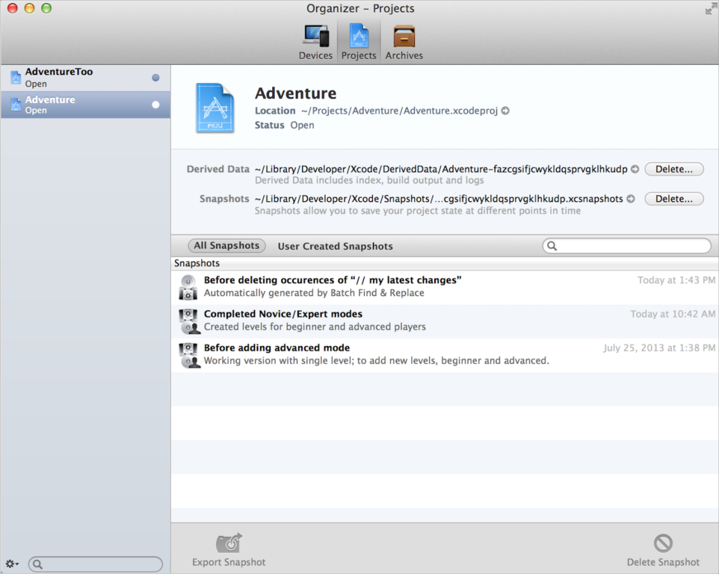
Automatic Saves, Project Snapshots, and Source Control Management
You can revert an entire project to a previous “snapshot” of a known working version with the Restore Snapshot command.
Xcode supports two popular source control systems: Git and Subversion.
Using the Xcode service, available with OS X Server, you can host Git repositories on your own server.
Notes:
123

Slide 11
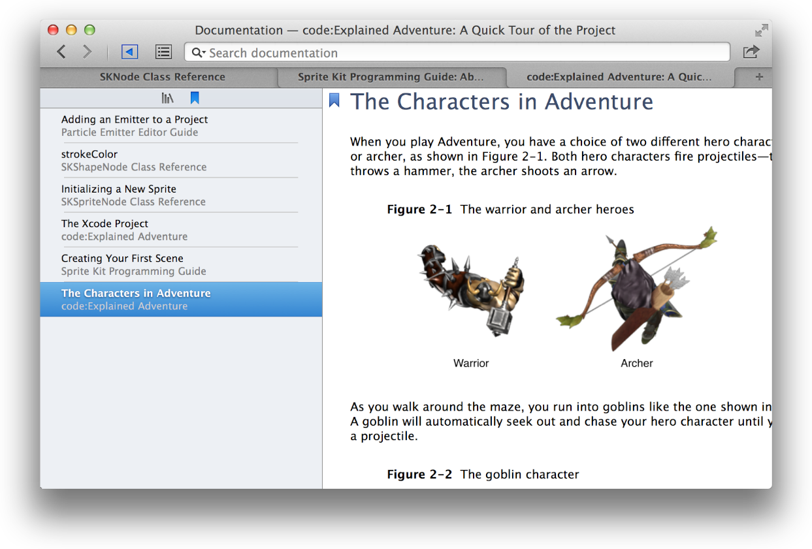
Integrated Documentation
While you’re coding, Xcode makes detailed technical information available at your fingertips. When you want it, Quick Help keeps concise API information always in view, and Xcode application help is always close at hand with step-by-step instructions for performing common Xcode tasks.
Xcode includes extensive documentation for using Xcode, and it provides comprehensive SDK documentation, including programming guides, tutorials, sample code, detailed framework API references, and video presentations by Apple engineers, all viewable from the Xcode documentation viewer.
As updated documentation becomes available, it downloads automatically in the background.
Notes:
123

Slide 12
Workspace Window

Slide 13



Workspace Window
The workspace window has five main components.
The workspace window always includes the editor area
The workspace window can also display three optional areas:
Show and hide the navigator area.
Show and hide the debug area.
Show and hide the utility area.
Notes:
123

Slide 14

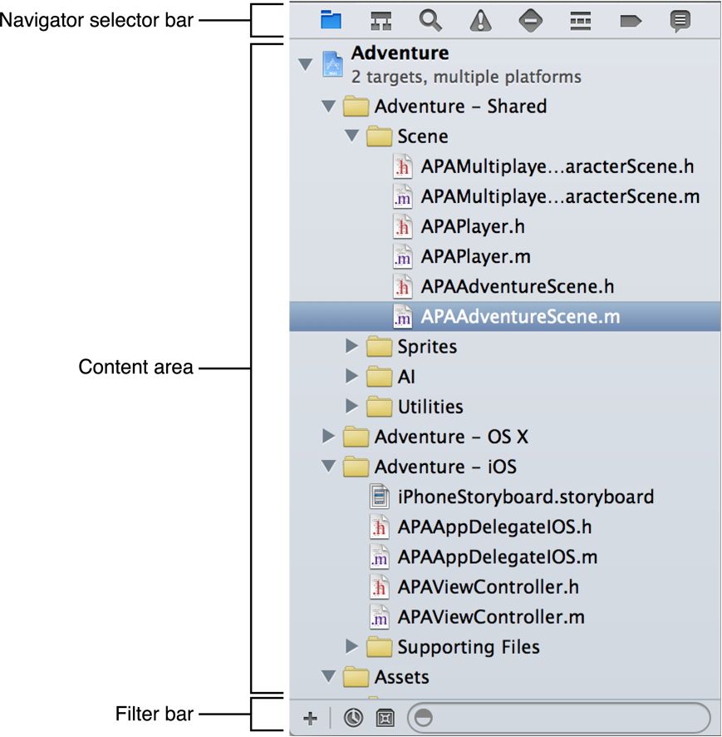







Navigate your workspace
Project navigator. Add, delete, group, and otherwise manage files in your project, or choose a file to view or edit its contents in the editor area.
Symbol navigator. Browse the class hierarchy of the symbols in your project.
Find navigator. Use search options and filters to quickly find any string within your project.
Issue navigator. View issues such as diagnostics, warnings, and errors found when opening, analyzing, and building your project.
Test navigator. Create, manage, run, and review unit tests.
Debug navigator. Examine the running threads and associated stack information at a specified point or time during program execution.
Breakpoint navigator. Fine-tune breakpoints by specifying characteristics such as triggering conditions.
Log navigator. View the history of your build, run, debug, continuous integration, and source control tasks.
Notes:
123

Slide 15
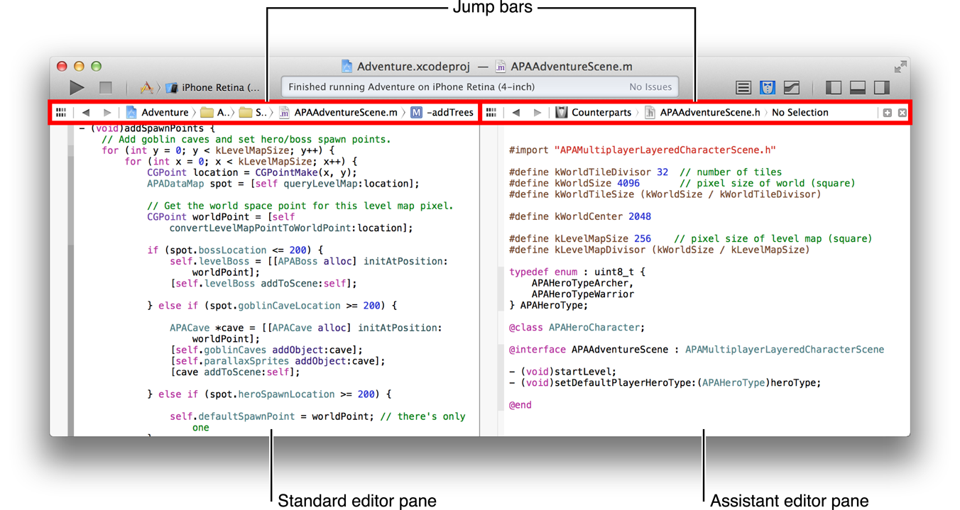

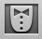

Configure the editor area
Standard editor. Fills a single editor pane with the contents of the selected file.
Assistant editor. Presents a separate editor pane with content logically related to that in the standard editor pane.
Version editor. Shows the differences between the selected file in one pane and another version of that same file in a second pane.
Notes:
123

Slide 16

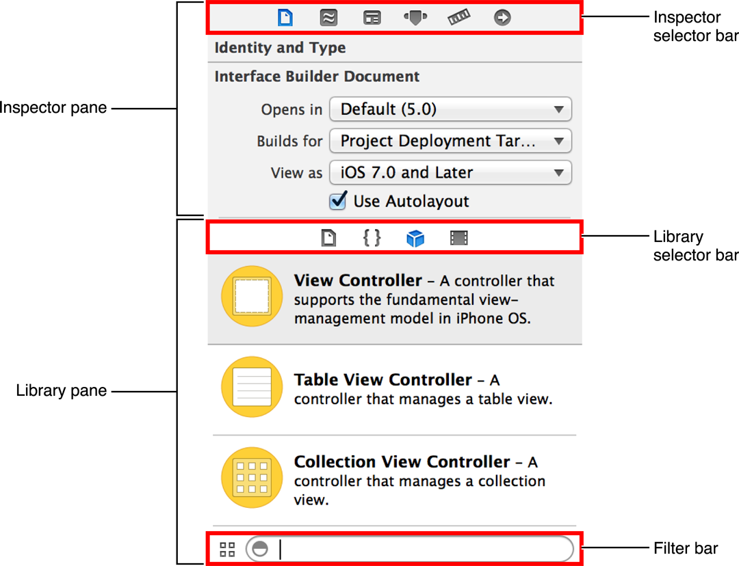



Additional Actions in the Utility Area
Use the inspector selector bar to choose the inspector best suited to your current task.
File inspector. Manage metadata for a file, such as its name, type, path, location within your project, and so forth.
Quick Help. View details about a symbol, interface element, or a build setting in the file.
Use the library selector bar to access ready-to-use libraries of resources for your project:
File templates. Model files for common types of files and code constructs.
Code snippets. Short pieces of source code for use in your software.
Objects. Items for your app’s user interface.
Media. Files containing graphics, icons, sound files, and the like.

Slide 17
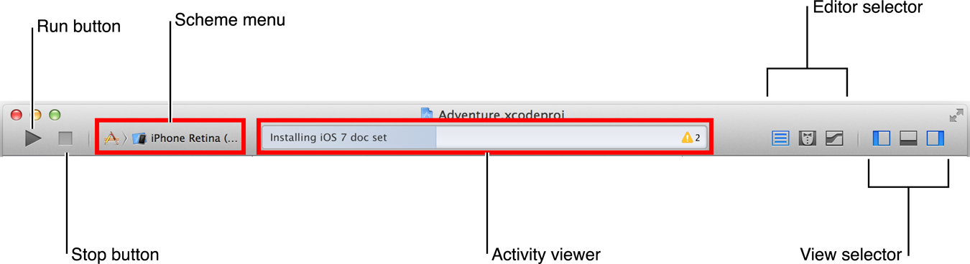
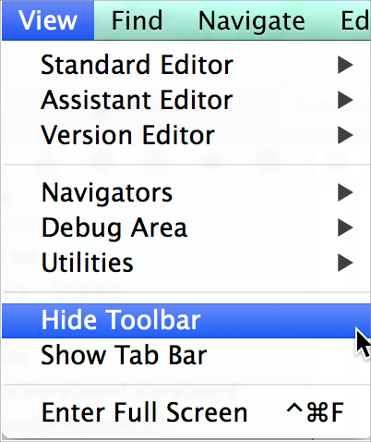
Workspace Toolbar
The toolbar at the top of the workspace window provides quick access to frequently used commands. The Run button builds and runs your products. The Stop button terminates your running code. The Scheme menu lets you configure the products you want to build and run. The activity viewer shows the progress of tasks currently executing by displaying status messages, build progress, and other information about your project.
The View menu includes commands to hide or show the toolbar.

Slide 18
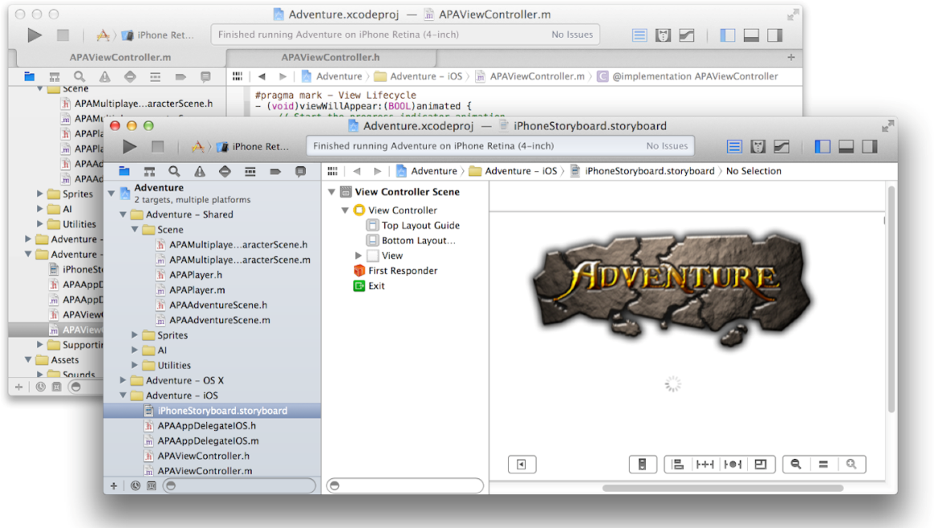
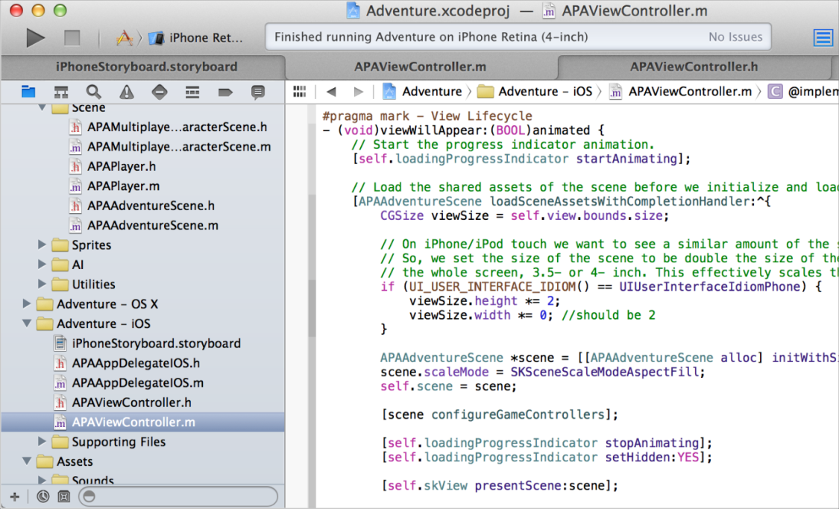
Multiple Tabs or Multiple Windows
The View menu contains commands to show or hide the tab bar.
To create a tab, choose File > New > Tab.
You can also create multiple workspace windows by choosing File > New Window. Each tab or window can be customized independently of the others.

Slide 19
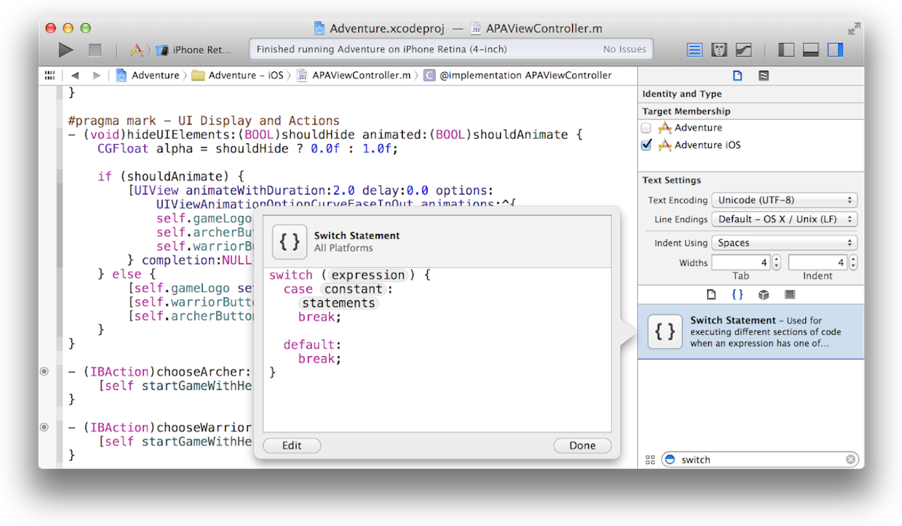
Drop Code Snippets into Your Files
You can drag a code snippet directly from the Code Snippet library into a source file.
The Code Snippet library is available by clicking the code snippet button
You can add your own code snippets to the library (drag your code to the snippet library).

Slide 20
Build a User Interface

Slide 21
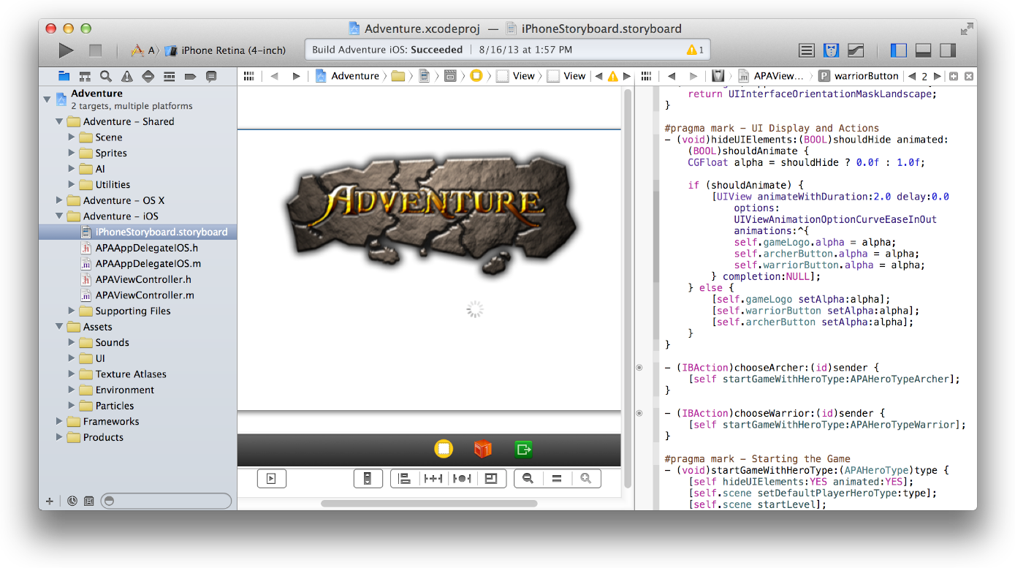
Build a User Interface
The contents of .xib and .storyboard files are stored by Xcode in XML format. At build time, Xcode compiles your .xib and .storyboard files into binary files known as nibs. At runtime, nibs are loaded and instantiated to create new views.
To add user interface elements, drag objects from the utility area into Interface Builder, where you arrange the elements, set their attributes, and establish connections between them and the code in your source files. As you lay out your app’s user interface elements in Interface Builder, you can write the code that implements their behavior in the assistant editor.

Slide 22
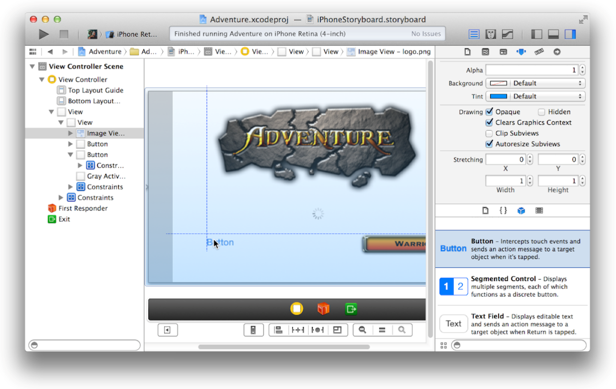
Add User Interface Elements from the Object Library
To add an object to your app’s user interface, open the utility area for the workspace window by clicking in the view selector in the toolbar.
Select the object library from the library pane by clicking in the library selector bar.
Drag an object (like Button in the screenshot) from the library to either the outline view in the dock or onto the canvas.

Slide 23
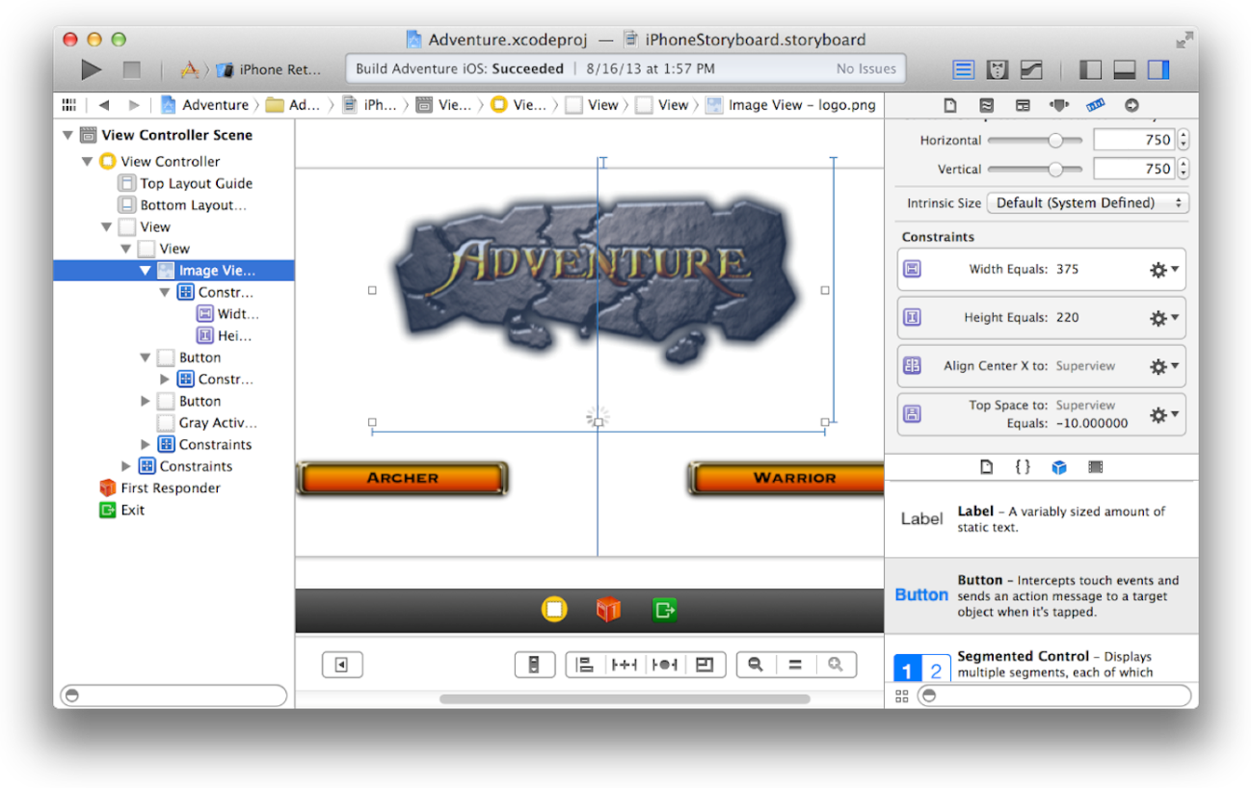
Lay Out User Interface Objects for Automatic Resizing and Positioning
Use Auto Layout to define relationship constraints for your app’s user interface so that when one object changes its size or position, that object and its neighboring objects adjust their sizes and positions appropriately.
With Auto Layout constraints governing the layout, the objects in your user interface automatically resize and reposition themselves whenever:
The user changes the screen orientation of an iOS device
The user resizes a window in a Mac app
Content dimensions change (for example, when the length of a text string changes in a label or button)
To see the constraints for an object, select the object from the outline view in the Interface Builder dock. Constraints are represented on the canvas by solid blue lines. View their properties in the size inspector ( ). From the size inspector, click the action ( ) icon to edit the properties of a constraint in the attributes inspector.

Slide 24
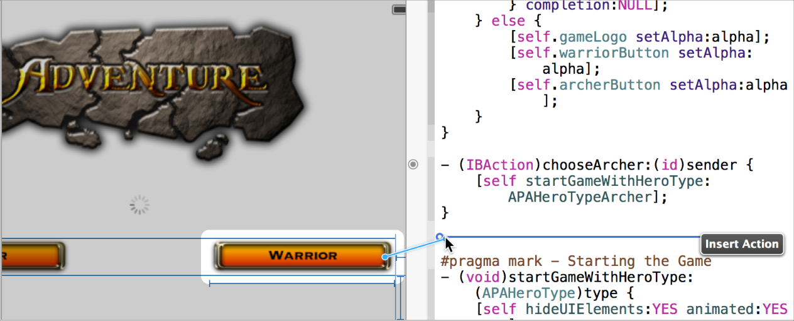
Send Action Messages from a Control to Your Code
With Interface Builder open in the standard editor pane, select the control you want to configure, and select the Assistant Editor button ( ) in the workspace toolbar. The assistant editor opens your object’s implementation file.
Control-drag from the control in Interface Builder to the implementation file. Xcode indicates where you can insert an action method in your code.
Release the Control-drag. The assistant editor displays a Connection menu. In this menu, type the name of the action method and click Connect.

Slide 25
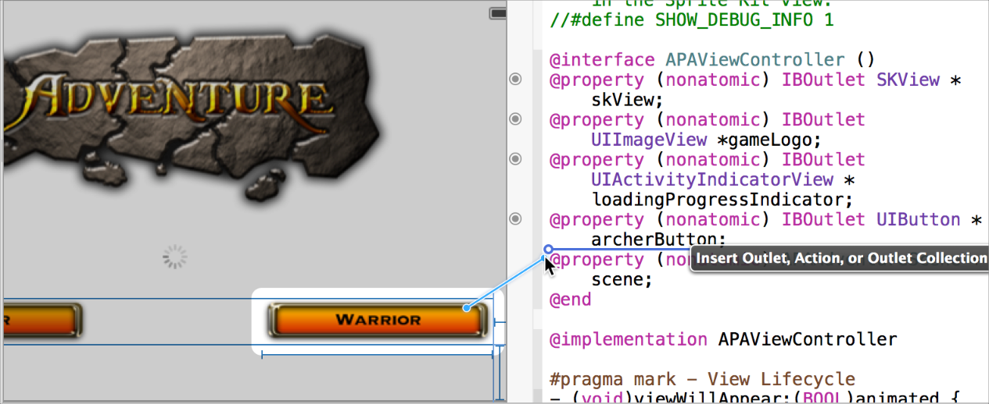
Send Messages to a User Interface Object Through an Outlet
To enable your code to send messages to a user interface object, connect the user interface object to an outlet in your code.
The easiest way to make an outlet connection is by Control-dragging from a user interface object in Interface Builder to the implementation file for another object.
Xcode indicates where you can insert an outlet declaration in your code.
Release the Control-drag. The assistant editor displays a Connection menu.
From this menu, choose Outlet, type the name of the outlet and click Connect.

Slide 26
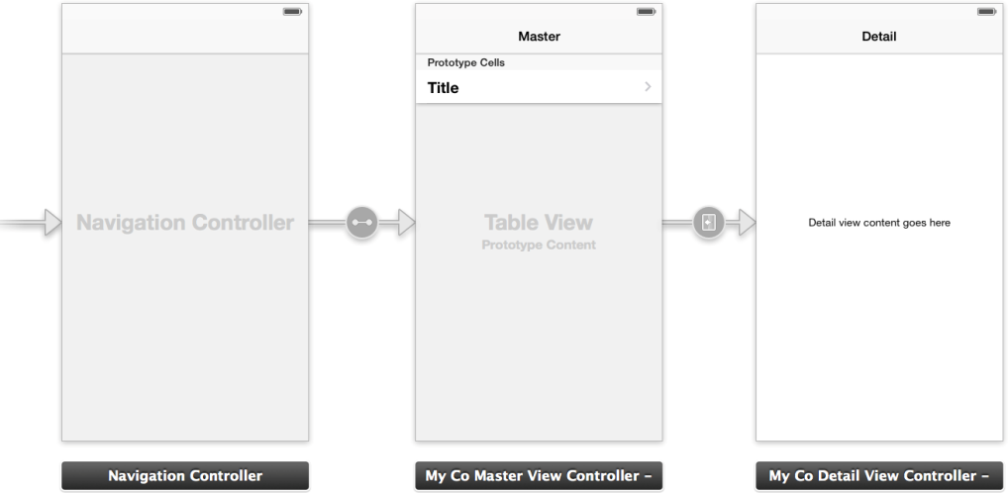
Design the User Interface of Your iOS App with Storyboards
You use a storyboard to graphically lay out the user’s path through your iOS app. Use Interface Builder to specify your user interface in terms of:
Scenes
Segues between scenes
Controls used to trigger the segues
The screenshot shows the default storyboard for an iOS project that you create in Xcode with the Master-Detail Application template.
This storyboard contains three scenes and two segues.
Add additional scenes as necessary by dragging view controllers from the object library to the canvas and configuring the view controller with the Identity inspector ( ).
Drag objects from the objects library to lay out each scene.
Configure the objects and the segues with the Attributes inspector ( ).

Slide 27
Icons, Images, and Effects

Slide 28
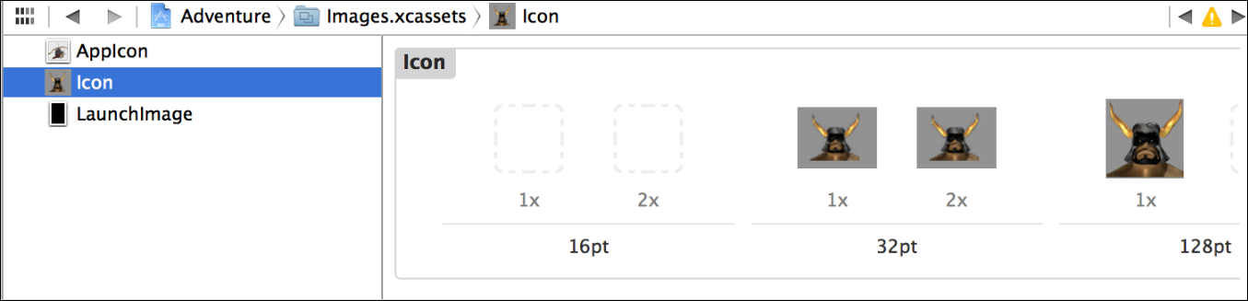
Asset catalog
To create and manage user interface elements for your app, Xcode offers several tools in addition to Interface Builder.
You create many images for your app, including icons, custom artwork, and launch screens for different iOS devices.
Some of these images are required for App Store submission. The asset catalog helps you manage them.
Create app icons for all of the operating system versions and devices that your app supports.
When you create a new project, Xcode creates an asset catalog named Images.xcassets. Select the asset catalog from the project navigator, and Xcode opens the catalog in the editor area.

Slide 29
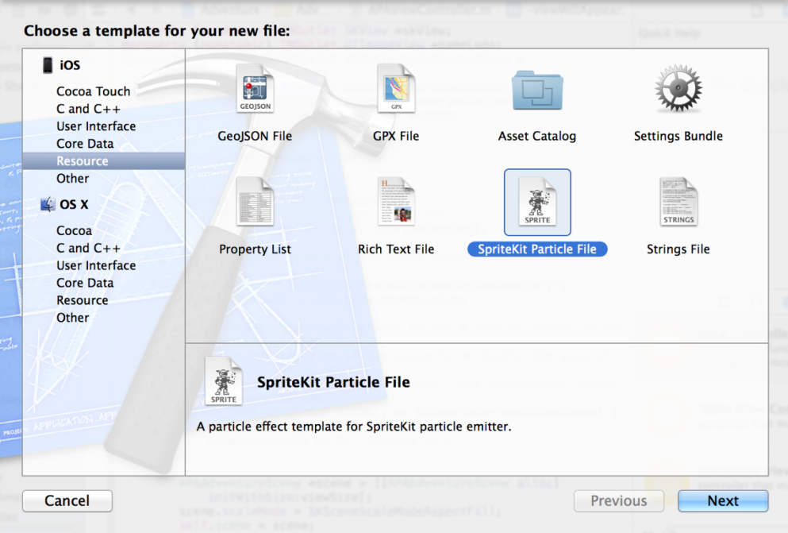
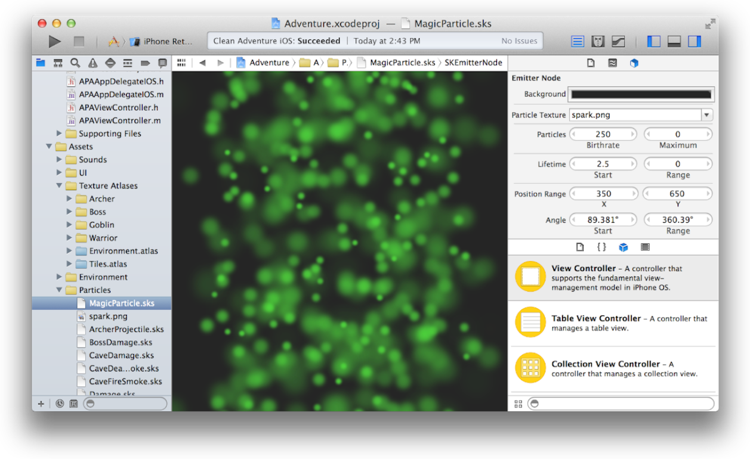
Add Particle Emitter Effects
Xcode provides eight particle emitter templates and an editor for manipulating the appearance and behavior of particles.
You can use particle emitters to simulate fire, rain, smoke, snow, sparks, and other animated effects.
Add a particle emitter to your project by choosing File > New > File and choosing Resource > SpriteKit Particle File.

Slide 30
Add 3D Scenes to Your Mac App
Scene Kit is a 3D-rendering framework for Mac apps. Scene Kit supports the import, manipulation, and rendering of 3D assets without requiring advanced 3D graphical programming skills on your part.
To import a COLLADA Data Asset Exchange (DAE) file into the project, use the project navigator. Select a folder in which you want to save the file. Choose File > Add Files, select the file, and click Add. To browse the 3D scene in Xcode, select the DAE file in the project navigator. Xcode opens the file in the Scene Kit editor.
To preview the scene and run animations, use the controls in the Scene Kit editor’s main area. Press the Play button to play an animation. Click the Pause button to pause the animation, and drag the slider to scroll through it. Use the trackpad or mouse to manipulate the point of view.
The inspectors in the utility area allow you to view and edit information about the node in the scene graph list or the object in the entities list. For example, with the nodes attributes inspector, you can adjust camera, light, or geometry attributes, and with the materials inspector, you can adjust many settings on a material and its properties, such as by selecting a lighting model for it and colors and textures for its contents.

Slide 31
Run Your App

Slide 32
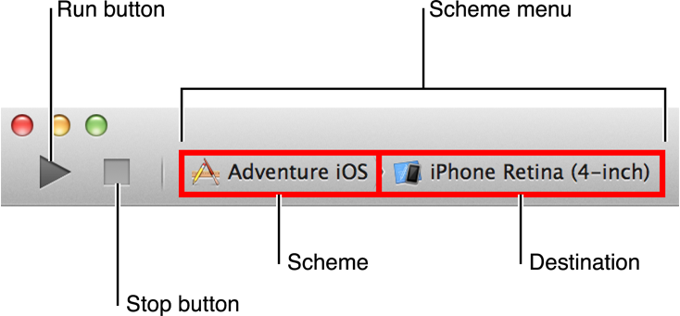
Choose a Scheme to Build Your App
To build and run your iOS or Mac app, choose a scheme and a run destination in the workspace toolbar, and click the Run button.
Clicking the Stop button causes your app to quit.
A scheme is a collection of settings that specify the targets to build for a project, the build configuration to use, and the executable environment to use when the product is launched.
The default scheme is named after your project and includes settings to perform five actions:
Run the app.
Run unit tests against the target.
Profile the app’s performance characteristics.
Perform static analysis on the code.
Archive the app for distribution, such as for sending to testers or submitting to the App Store.
Each action includes building the app as an executable product. To choose the scheme, use the Scheme menu in the Xcode workspace toolbar.
When you build an app, the destination determines where the app runs after it’s built. For iOS apps, the destination can be a provisioned iOS device connected to the Mac, or iOS Simulator.

Slide 33
Run Your App
Run Your App in iOS Simulator
iOS Simulator enables you to simulate several iPhone and iPad devices and several versions of the iOS operating system. You interact with iOS Simulator by using the keyboard and trackpad to emulate taps, device rotation, and other actions. For example, you can use the Hardware menu in iOS Simulator to:
Rotate the simulator to the left and right
Simulate a user shaking the device
Send the frontmost app a simulated low-memory warning
Run Your App on a Connected Device
To run your iOS app on a device (an iPad, iPhone, or iPod touch) during development, the device must be connected to your Mac, and the device must be provisioned for development by Apple.
Apple implements an underlying security model to protect user data and to protect your app from being modified and distributed without your knowledge. Throughout the development process, you create assets and enter information that Apple uses to verify the identify of you, your devices, and your apps. These assets include provisioning profiles, which identify your development devices.
To obtain a provisioning profile for a device, you need an Apple Developer Program membership.

Slide 34
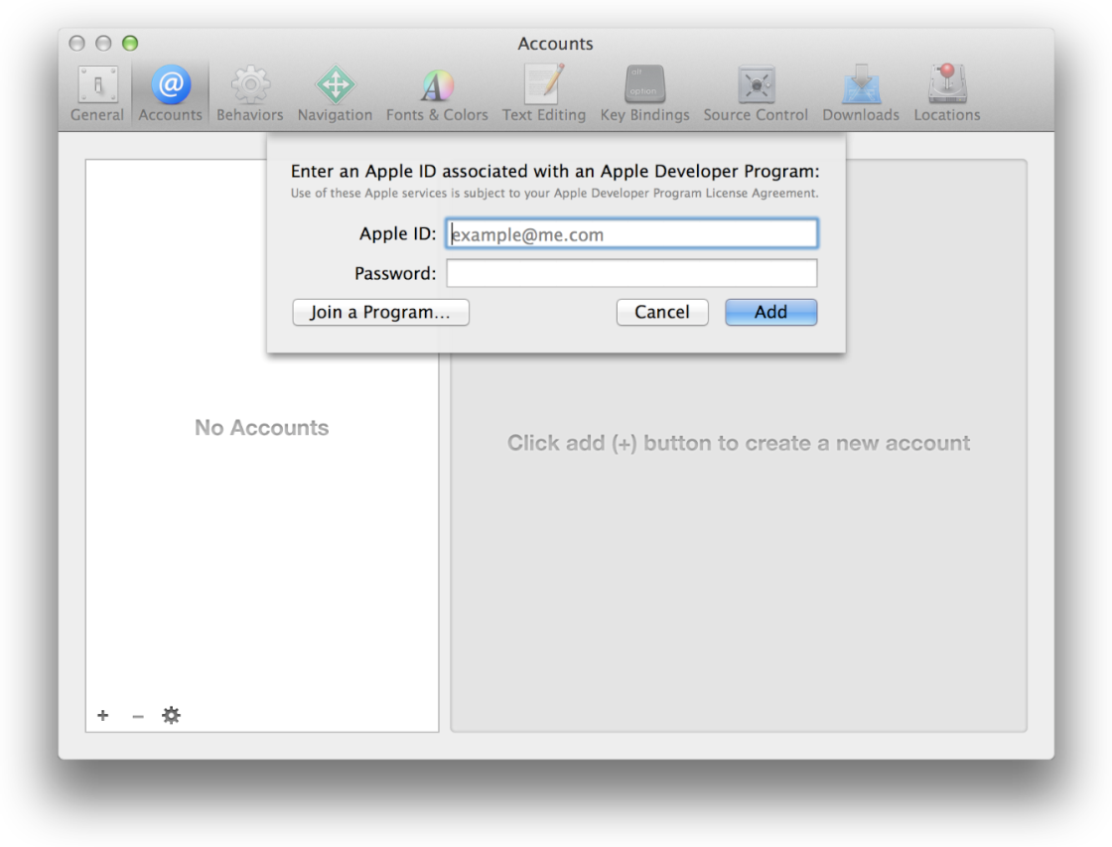
Add an Apple Developer Program Account to Xcode
If you’re not already a member, you can join an Apple developer program in Xcode.
To join, choose Xcode > Preferences, and click Accounts.
Click the Add button (+) in the lower-left corner, and select Add Apple ID from the pop-up menu.
Click “Join a Program” in the lower-left corner of the dialog.

Slide 35
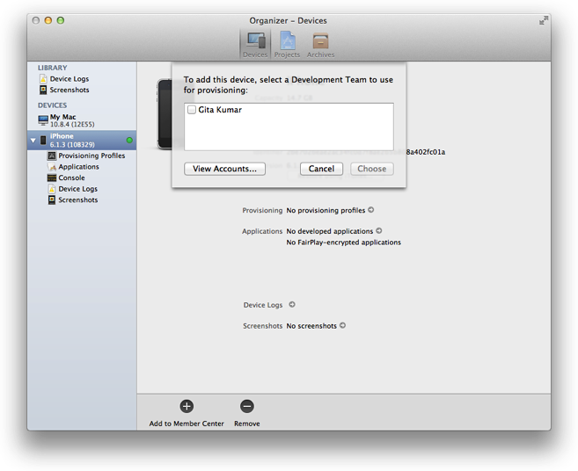
Provision an iOS Device for Development
To provision an iOS device in Xcode, choose Window > Organizer, and click Devices to display the Devices organizer.
For an iOS app, connect your device to your Mac. In the Devices section of the Devices organizer, select your device. Click the “Use for Development” button (or if the device was previously used for development, click the “Add to Member Center” button). Select the checkbox next to your Apple developer program account name, and click Choose

Slide 36
Debug Your App

Slide 37
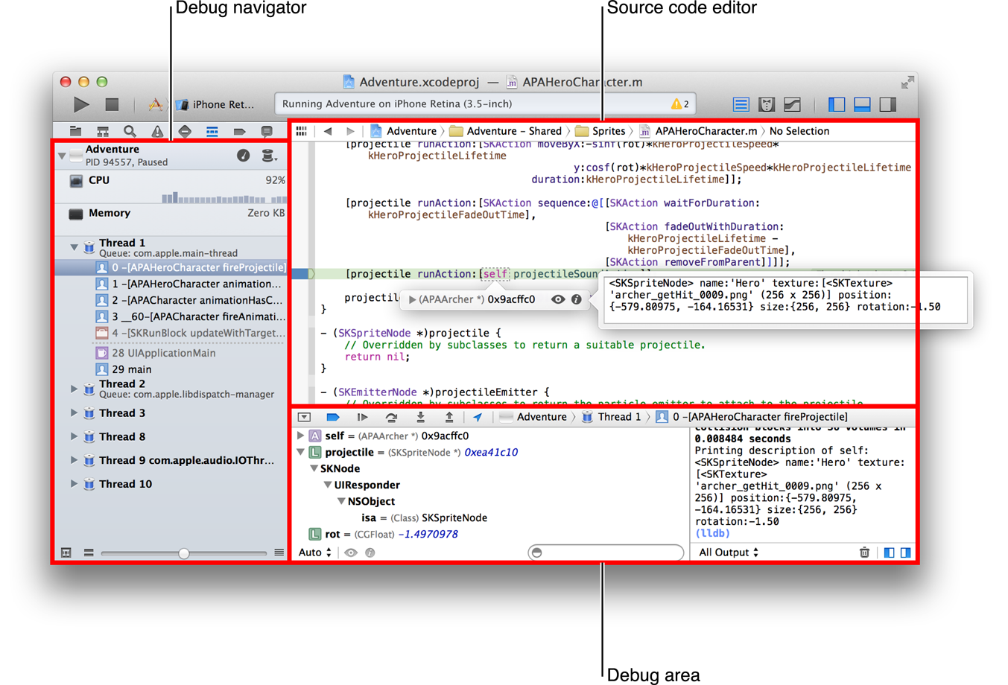
Debug Your App
After you click the Run button in the workspace toolbar and your app builds successfully, Xcode runs your app and starts a debugging session.
You can debug your app directly within the source editor with graphical tools such as data tips and the variables Quick Look.
The debug area and the debug navigator let you inspect the current state of your running application and control its execution.
Use the debug gauges in the debug navigator to gain insight into your app’s resource consumption, and when you spot a problem, use Instruments to measure and analyze your app’s performance.

Slide 38
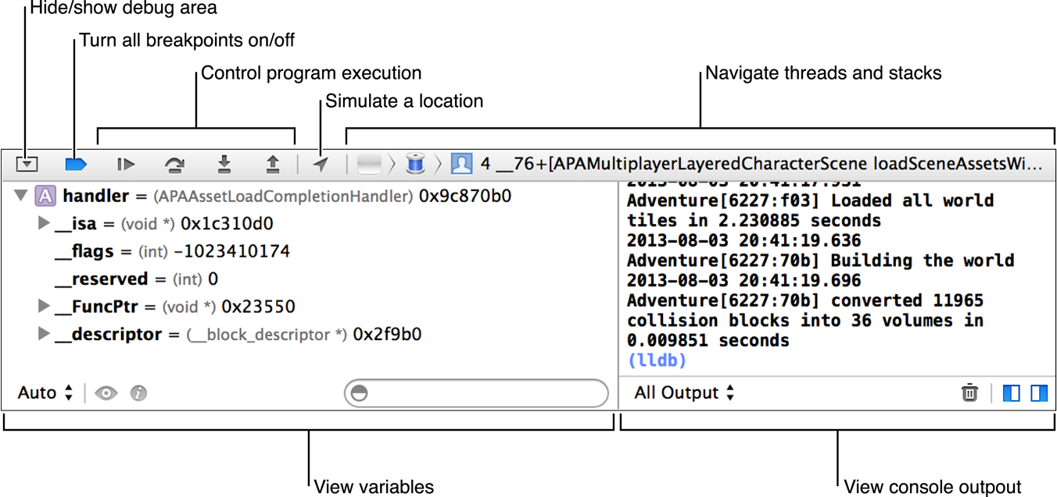
Control Execution
Xcode lets you step through your code line by line to view your program’s state at a particular stage of execution.
Use the debug area to control the execution of your code, view program variables and registers, view its console output, and interact with the debugger.
Display the debug area by clicking the center button ( ) in the view selector in the workspace window toolbar.

Slide 39
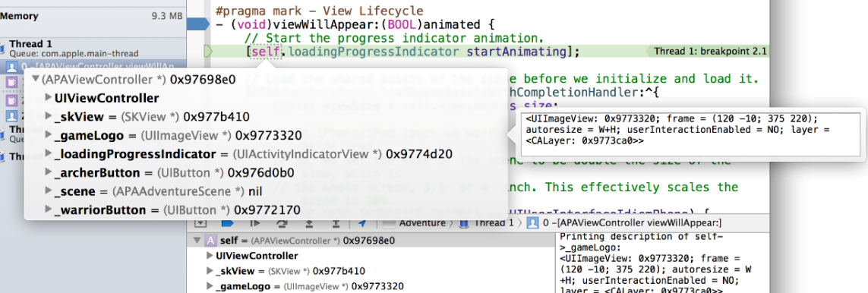


View State Information
Hover over any variable in the source code editor to see a data tip displaying the value for the variable. Click the inspector icon ( ) next to the variable to print the Objective-C description of the object to the debug area console and to display that description in an additional popover.
Click the Quick Look icon ( ) to see a graphical display of the variable’s contents.

Slide 40
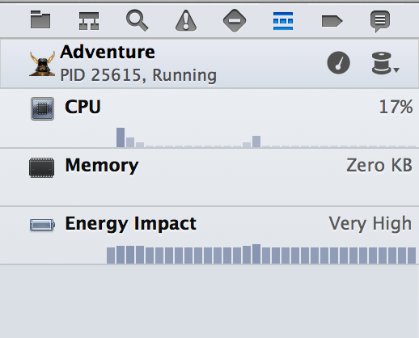
Examine Your App’s Impact on System Resources
The debug navigator displays gauges that provide insight into how your app is performing.
Depending on the capabilities of your app and the characteristics of its destination, gauges can report your app’s impact on memory, iCloud, OpenGL ES, energy, and the CPU.
To see a full report, click a gauge in the debug area. To perform a deeper analysis of your app’s performance, click the “Profile in Instruments” button.

Slide 41
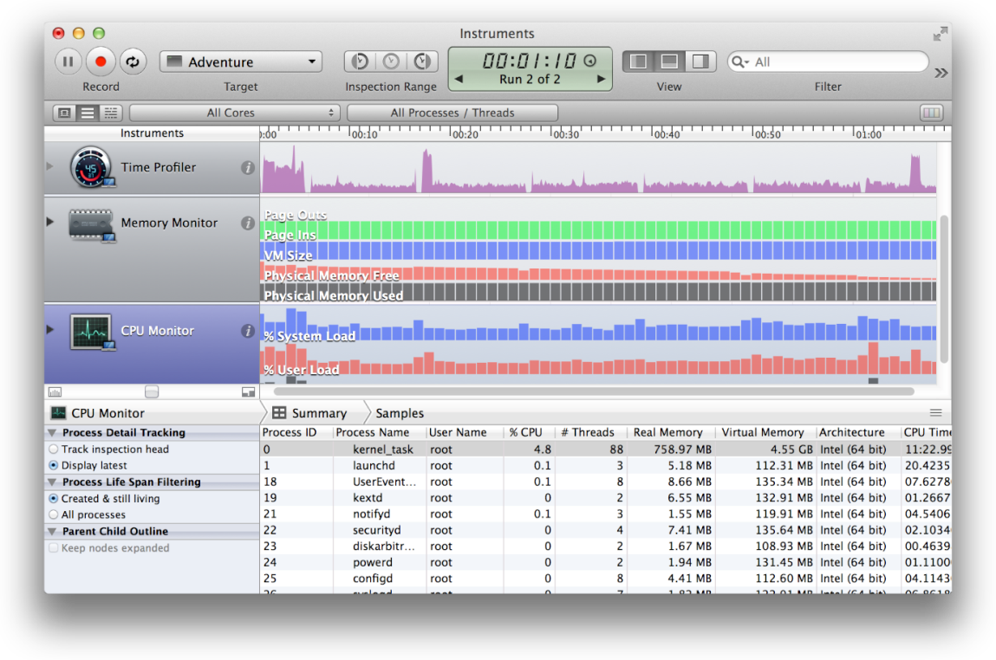
Measure Your App’s Performance
The Instruments app, which is included with Xcode, gathers data from your running app and presents it in a graphical timeline.
With Instruments, you can gather data about such performance areas as your app’s memory usage, disk activity, network activity, and graphics operations.
By viewing the data together, you can analyze different aspects of your app’s performance to identify potential areas of improvement. You can also automate the testing of your iOS app’s user interface elements.
There are several ways to start Instruments from Xcode. For example:
Click the Profile in Instruments button from a debug gauge report.
Choose Product > Profile.
Specify an Instrument in the Profile action for a scheme.

Slide 42
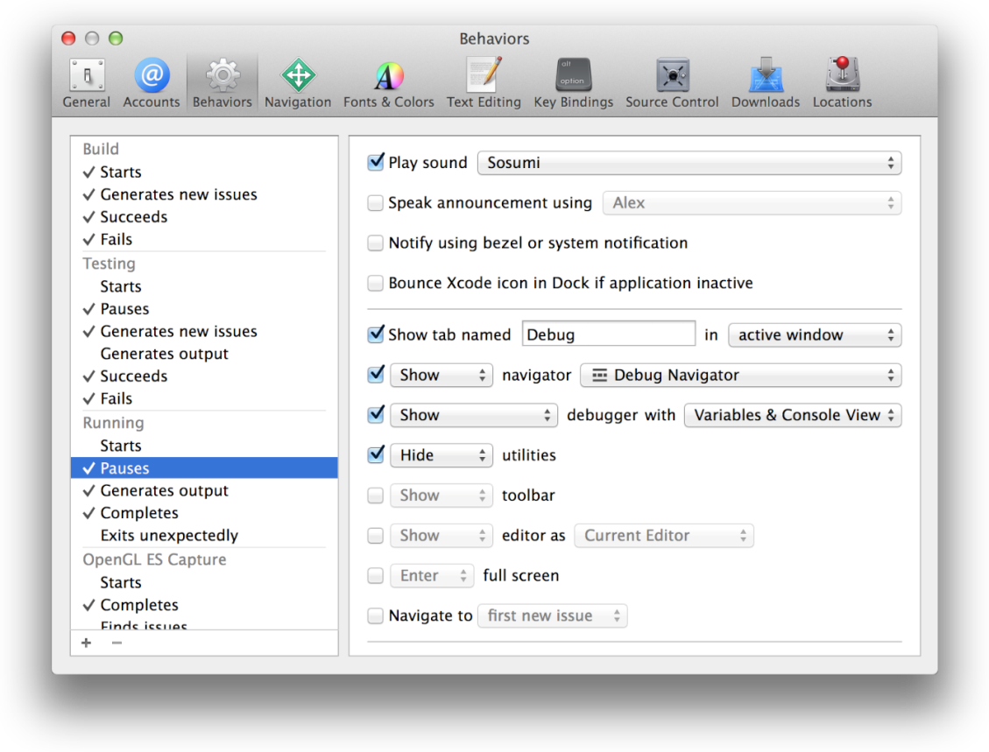
Customize Your Debugging Workflow
You can specify behaviors that affect your workflow through the Xcode Behaviors preferences.
Choose Xcode > Behaviors to specify what should happen when a variety of events occur while building, running, and debugging your app.
In this screenshot, behaviors are customized for whenever the code pauses.
Here are some examples of customized behaviors:
Play an alert sound at every pause.
Create a tab named Debug in the workspace window for displaying the debug navigator.
Show both the variables view and the console view in the Debug tab.
Hide the utilities area in the Debug tab.

Slide 43
Unit Test Your App

Slide 44
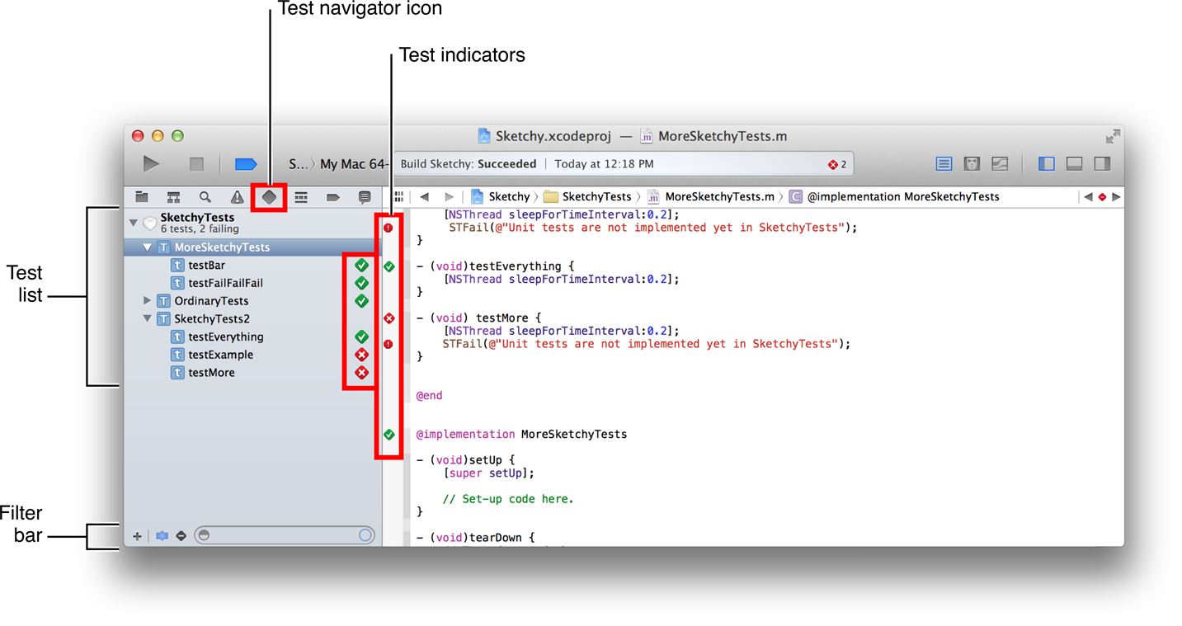
Create and Run Unit Tests
A unit of code is the smallest testable component of your project. A test case exercises a unit of code in a specific way; if the result of the test is different from the expected result, the test case fails. A test suite is made up of a set of test cases. You create test suites based on the XCTest framework.
When you create a project or a target, Xcode includes a unit test target in the scheme that builds the app. The implementation file for the target includes stubs for the setUp, tearDown, and testExample methods. Complete these stub implementations and add other code as necessary to perform unit tests on your app.
To run a test suite, click the arrow to the right of the name. To run a subset of test methods, select them in the test navigator and choose Product > Perform Action > Run Test methods.
Choose Product > Test to run all tests in the active scheme.

Slide 45
Save and Revert Changes

Slide 46
Use Snapshots to Restore Projectwide Changes
The Revert Document and Undo commands are not supported for three types of projectwide changes:
Xcode operations that involve changes to many document files and potentially to project settings. These operations include refactoring code, performing project validation, and adding Automatic Reference Counting to an existing project.
Adjustments to the workspace and project settings.
Global search and replace operations.
Therefore, use a snapshot to revert changes across a project.
Xcode automatically creates a project or workspace snapshot before you perform any mass-editing operation, such as refactoring your code or executing a Find and Replace operation.
You can also create a snapshot manually by choosing File > Create Snapshot.

Slide 47
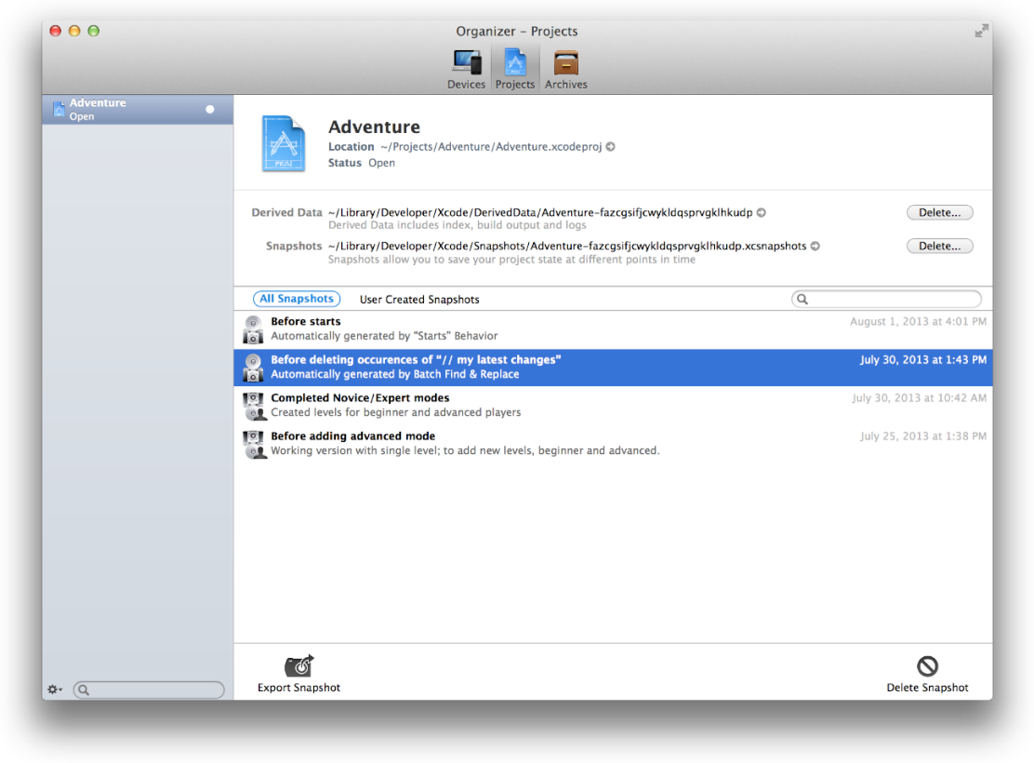
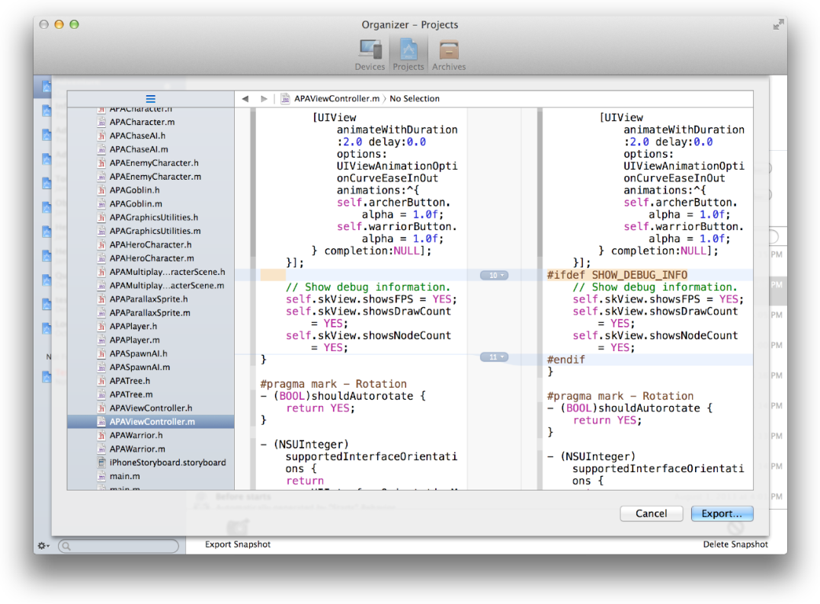
Use Snapshots to Restore Projectwide Changes (end)
To see the snapshots for a project or workspace, choose Window > Organizer, select Projects to open the projects organizer, and click the project.
Select a project or workspace, select a snapshot, and click the Export Snapshot button at the bottom of the window.
Choose File > Restore Snapshot from the project’s workspace window to restore.

Slide 48
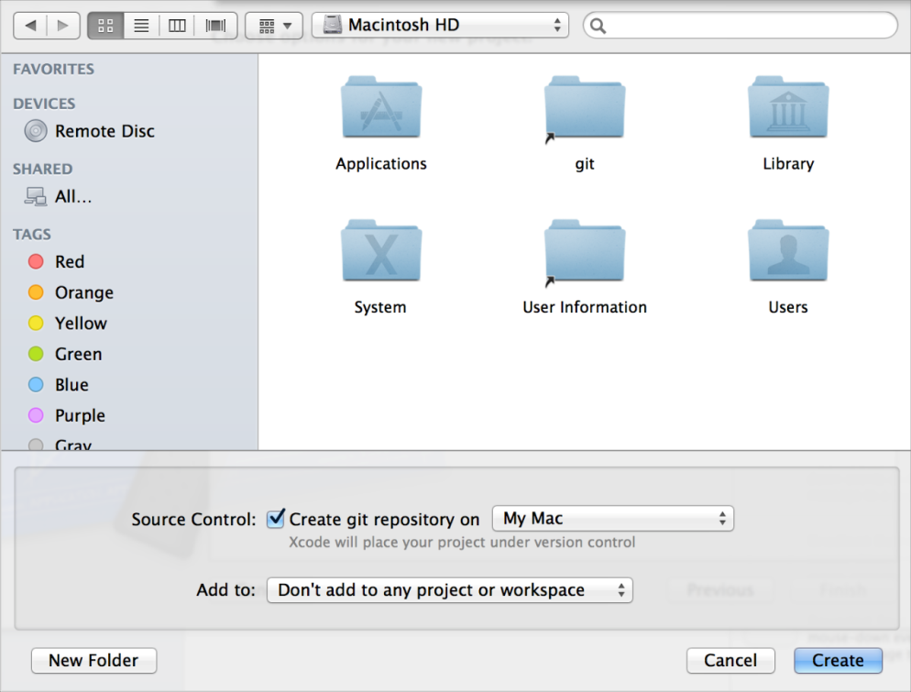
Store and Track Changes with Source Control
Xcode supports two popular source control systems: Git and Subversion.
If you are working alone, it’s easiest to use Git, because you won’t need to set up a server.
When you create a project, Xcode automatically sets up a Git repository for you.
If your repository is on a server, choose Source Control > Check Out to create a local working copy of the project on your computer.
Choose Source Control > Commit to ensure that those changes are preserved in the repository.
Perform a push operation to add your committed changes to the Git repository on the server.

Slide 49
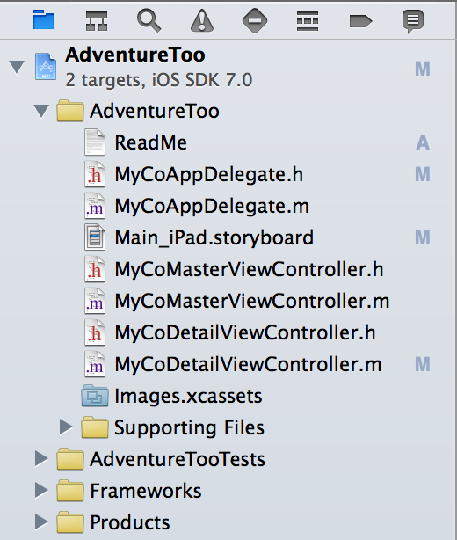
Source Control Status of files
You can see the source control status of your files in the project navigator.
Badge | SCM status
M | Locally modified
U | Updated in repository
A | Locally added
D | Locally deleted
I | Ignored
R | Replaced in the repository
– | The contents of the folder have mixed status; display the contents to see individual status
? | Not under source control

Slide 50

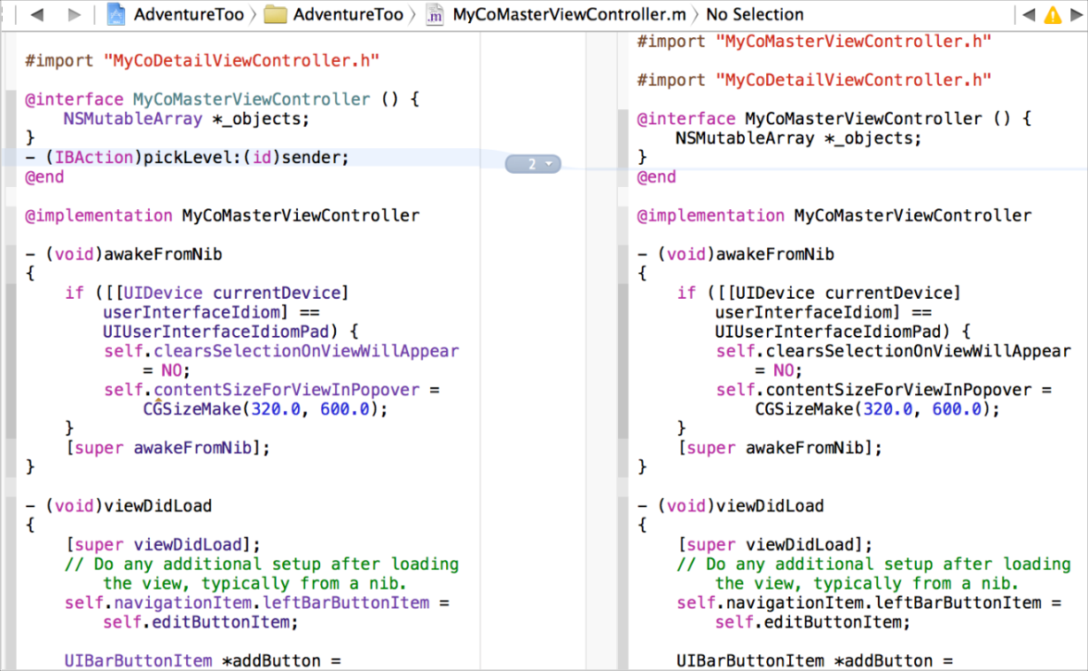
Compare File Versions to Revert Lines of Code
Choose View > Version Editor > Show Comparison View to compare versions of files saved in a repository.
To display a version, browse through the hierarchy to find it, then click to choose it.
Shaded areas indicate changes between versions.
Click the timeline viewer icon ( ) in the center column to display the timeline between the two editing panes.

Slide 51
Questions?

Slide 52
Revision History
Author | Description | Revision | Date
Vladimir Tyutin | Initial Draft | 2.1 | TDB

